Slide 1
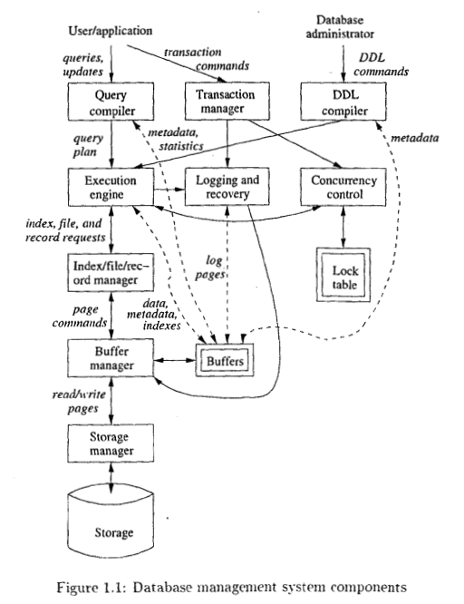
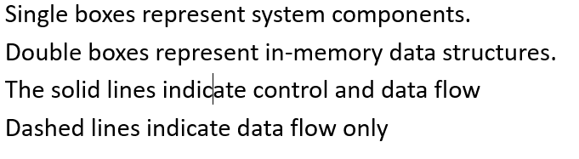
Overview of a Database Management System

Slide 2
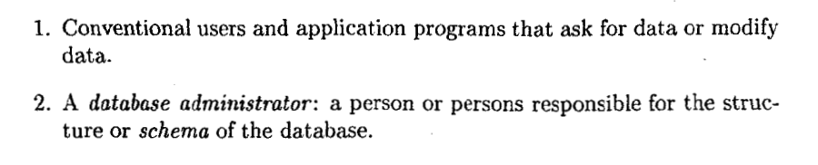
Overview of a Database Management System
Single boxes represent system components.
Double boxes represent in-memory data structures.
The solid lines indicate control and data flow
Dashed lines indicate data flow only

Slide 3
Overview of a Database Management System
Database administrator, or DBA, for a university registrar's database might decide that there should be a table or relation with columns for a student, a course the student has taken, and a grade for that student in that course.
This structure and constraint information is all part of the schema of the database and entered by the DBA, who needs special authority to execute schema-altering commands, since these can have profound effects on the database.
These schema-altering DDL commands ("DDL," stands for "data-definition language") are parsed by a DDL processor and passed to the execution engine, which then goes through the index/file/record manager to alter the metadata, that is, the schema information for the database.

Slide 4
Overview of a Database Management System
A user or an application program initiates some action that does not affect the schema of the database, but may affect the content of the database (if the action is a modification command) or will extract data from the database (if the action is a query).
The language in which these commands are expressed is called a data-manipulation language (DML)

Slide 5
Overview of a Database Management System
The query is parsed and optimized by a query compiler.
The resulting sequence of actions the DBMS will perform to answer the query, is passed to the execution engine.
The execution engine issues a sequence of requests for small pieces of data, typically records or tuples of a relation, to a resource manager that knows about data files, the format and size of records in those files, and index files, which help find elements of data files quickly.
The requests for data are translated into pages and these requests are passed
to the buffer manager. Buffer manager brings appropriate portions of the data from secondary storage (disk, normally) where it is kept permanently, to main memory buffers.
The buffer manager communicates with a storage manager to get data from
disk. The storage manager might involve operating-system commands, but
more typically, the DBMS issues commands directly to the disk controller.

Slide 6
Overview of a Database Management System
Transaction processing
Queries and other DML actions are grouped into transactions, which are units that must be executed atomically and in isolation from one another.
Often each query or modification action is a transaction by itself. In addition, the execution of transactions must be durable, meaning that the effect of any completed transaction must be preserved even if the system fails in some way right after completion of the transaction.
Transaction processor is divided into two major parts:
1. A concurrency-control manager, or scheduler, responsible for assuring atomicity and isolation of transactions, and
2. A logging and recovery manager, responsible for the durability of transactions

Slide 7
Overview of a Database Management System
Storage and Buffer Management
The data of a database normally resides in secondary storage
To perform any useful operation on data, that data must be in main memory.
It is the job of the storage manager to control the placement of data on disk and
its movement between disk and main memory.
In a simple database system, the storage manager might be nothing more
than the file system of the operating system.
The storage manager keeps track of the location of files on the disk and obtains the block or blocks containing a file on request from the buffer manager.
The buffer manager is responsible for partitioning the available main memory into buffers, which are page-sized regions into which disk blocks can be transferred.

Slide 8
Overview of a Database Management System
Storage and Buffer Management
Thus, all DBMS components that need information from the disk
will interact with the buffers and the buffer manager, either directly or through the execution engine.
The kinds of information that various components may need include:
1. Data: the contents of the database itself.
2. Metadata: the database schema that describes the structure of, and constraints on, the database.
3. Statistics: information gathered and stored by the DBMS about data
properties such as the sizes of, and values in, various relations or other
components of the database.
4. Indexes: data structures that support efficient access to the data.

Slide 9
Overview of a Database Management System
Transaction Processing
It is normal to group one or more database operations into a transaction, which is a unit of work that must be executed atomically and in apparent isolation from other transactions.
In addition: a DBMS offers the guarantee of durability: that the work of a completed transaction will never be lost.

Slide 10
Overview of a Database Management System
The Query Processor
The portion of the DBMS that most affects the performance that the user sees is the query processor. In Fig. 1.1 the query processor is represented by two components:
1. The query compiler which translates the query into an internal form called a query plan which is a sequence of operations to be performed on the data.

Slide 11
Overview of a Database Management System
The query compiler consists of three major units:
(a) A query parser, which builds a tree structure from the textual form of the query.
(b) A query preprocessor, which performs semantic checks on the query (e.g.; making sure all relations mentioned by the query actually exist), and performing some tree transformations to turn the parse tree into a tree of algebraic operators representing the initial query plan.
(c) A query optimizer, which transforms the initial query plan into the best available sequence of operations on the actual data.
2. The execution engine, which has the responsibility for executing each of
the steps in the chosen query plan. The execution engine interacts with
most of the other components of the DBMS, either directly or through
the buffers. It must get the data from the database into buffers in order
to manipulate that data. It needs to interact with the scheduler to avoid
accessing data that is locked, and the log manager to make sure that
all database changes are properly logged.

